Slide 1
Jim Gillie Director of Construction Services, UC San Diego
DESIGN-BUILD INSTITUTE OF AMERICA - Western Pacific Region
Thursday, February 9, 2012
11:30 am – 1:30 pm

Slide 2
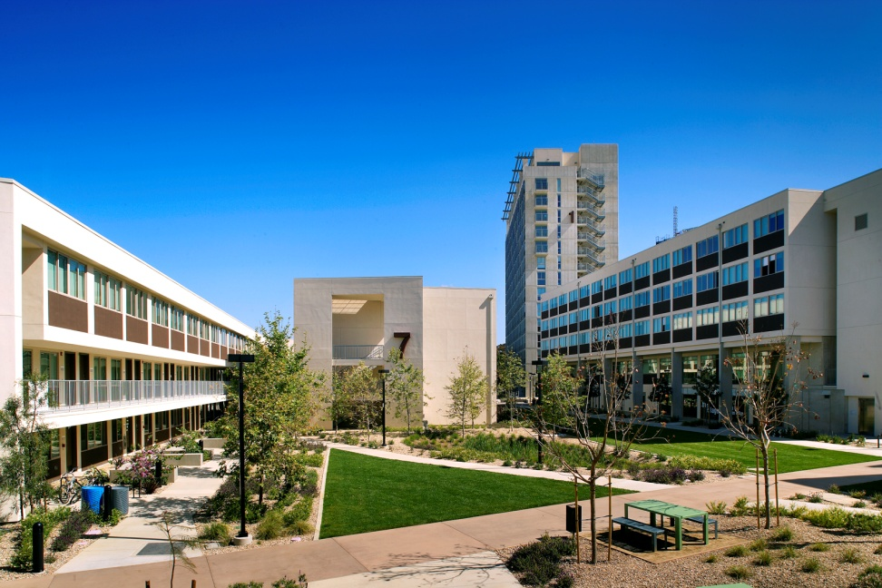
Design-Build Lessons Learned
Under what circumstances does UC San Diego use Design-Build?
Clients:
Project Program:
Project Location:
The Village at Torrey Pines

Slide 3
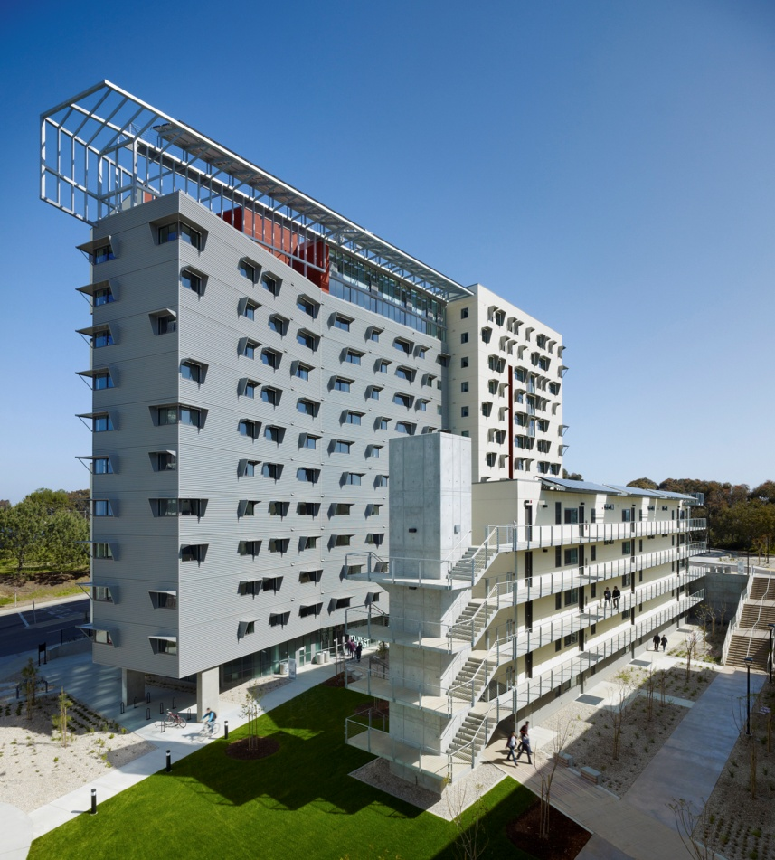
Design-Build Lessons Learned
Ecoflats
How does UC San Diego deliver a Design-Build project?
Traditional:
Master Architect:
RFQ: Projects & Team
1:1 Meetings: Confidential
RFP & Stipend:

Slide 4
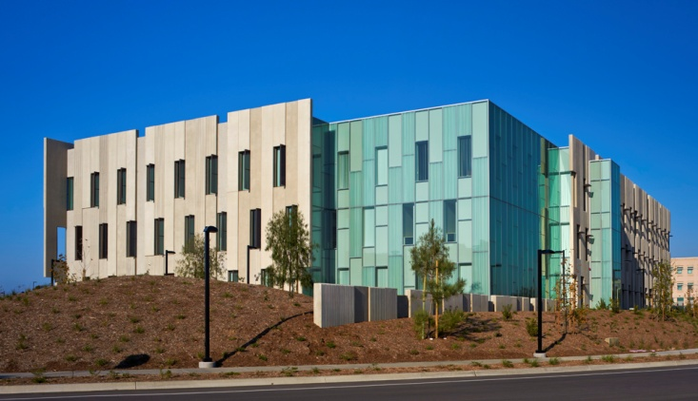
Design-Build Lessons Learned
What is the basis of award?
Best Value:
Fixed Price:
Enhancement Points:
Lowest Cost per point:
East Campus Office Building

Slide 5
Design-Build Lessons Learned
Miramar One
What are the results?
Quality:
Schedule:
Budget:
Scope:

Slide 6
Design-Build Lessons Learned
What can we improve?
Scope:
Rita Atkinson Grad Housing

